Slide 1
AI Fundamentals, MMAI 5000 S1 – Introduction to AI Hemant Sangwan

Slide 2
Agenda – AI Fundamentals
What is Artificial Intelligence (historical perspectives, evolutions, etc.)?
Present the core and fundamental aspects of Artificial Intelligence
-- abilities to solve problems and learn new stuff
-- comprehensive thinking
-- application of knowledge, transferable skills
-- critical thinking
Define key terms in AI – analytics, machine learning, deep learning, neural network, etc.
Identify and analyze goals that are related to the use of Artificial Intelligence in organizations
Capabilities and limitations of AI
Introduce the key applications areas of Artificial Intelligence – natural language processing (NLP), image processing, intelligent systems, and robotics
Discuss drivers of growth in AI, the socio-economic effects, and economic development attributed to AI in different countries

Slide 3
What is Artificial Intelligence?

Slide 4
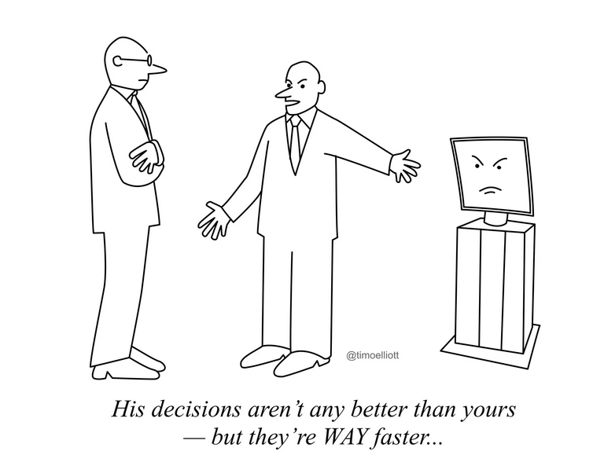
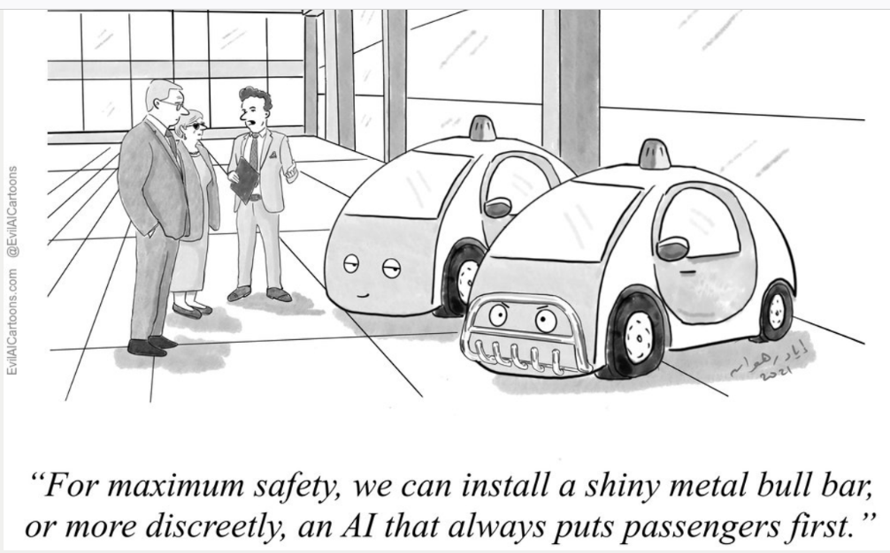
What is Artificial Intelligence?
Source: Timo Elliott

Slide 5
The concept – (Artificial) Intelligence
What is Intelligence?
Problem solving, decision making, learn to reason, discovery of knowledge, critical thinking
Applying knowledge to new and unknown situations
Identifying useful and non-useful information
Replicating tasks with speed and precision
Situational awareness (The Things You Can Do to Survive a Plane Crash: https://slate.com/business/2025/03/airline-accidents-the-things-you-can-do-to-survive-a-plane-crash.html?utm_source=firefox-newtab-en-us )
Prediction

Slide 6
The concept – (Artificial) Intelligence
What is Intelligence as a concept?
Abstract
Multidimensional
Transferable to a limited extent and scope
Gradual
-- Evolution. Ex: in the old time, intelligence can be referred as survival skills.
If a machine can exhibit these characteristics, then it is considered “intelligent”

Slide 7
Evolution of (Artificial) Intelligence
Gradual – exhibiting intelligence in basic tasks before moving to complex difficult tasks
Machine: calculator → computer → advanced computer
Human: hunting → early settlement → agriculture →

Slide 8
Artificial Intelligence – Expert views
“AI is whatever hasn’t been done yet.” Hofstadter
“The development of full artificial intelligence could spell the end of the human race….It would take off on its own, and re-design itself at an ever-increasing rate. Humans, who are limited by slow biological evolution, couldn’t compete, and would be superseded.” Stephen Hawkins
“Some people call this artificial intelligence, but the reality is this technology will enhance us. So instead of artificial intelligence, I think we’ll augment our intelligence.” Ginni Rometty
“Nobody phrases it this way, but I think that artificial intelligence is almost a humanities discipline. It’s really an attempt to understand human intelligence and human cognition.” Sebastian Thrun

Slide 9
Types of Artificial Intelligence
Narrow AI: AI that applies within a narrow domain such as chess or medicine
AGI (Artificial General Intelligence): Human-like general intelligence, similar to human-level intelligence
Strong AI [Searle(1980)]: Machine that does not only appear intelligent but has its own mind (i.e., consciousness) and understands. Sometimes similar to human-level intelligence and AGI
Weak AI [Searle(1980)]: Behaves intelligently, but no consciousness. Sometimes similar to narrow AI
Human-level intelligence: AI that applies broadly across diverse domains

Slide 10
Task based Artificial Intelligence – Turing Intelligence
The Turing test (From the article “Computing Machinery and Intelligence” by Alan Turing, 1950)
Instead of asking if a machine can think, ask instead if it can pass a behavioural intelligence test
If you cannot tell that it is a machine, then it is intelligent (i.e., passes the test)
Turing test: A human interrogator holds a 5-min textual (typed) conversation with either a machine or a person
Total Turing test: the interrogator has visual information about the artificial entity so that the ability to perceive, navigate, and manipulate can be tested too
The machine passes the test if it fools the interrogator at least 30% of the time

Slide 11
The Loebner Prize – An AI competition
The Loebner Prize (32 minutes): https://youtu.be/ruueEq_ShFs?si=37XK5bbZCgXxfM_8
A human judge holds 25 min of textual conversations with both a computer program and a human being via computer
Winner 2013, 2016, 2017, 2018 & 2019: Mitsuku
Defunct since 2020

Slide 12
Alan Turing (1912-54)
Alan Turing gave AI lectures as early as 1947 although it was not called AI at the time
He also proposed terms Machine learning, Genetic algorithms, Reinforcement learning
AI agenda 1950 in “Computing Machinery and Intelligence.”
The Turing Test
The Turing Machine
Turing completeness
“Alan Turing – Celebrating the life of a genius” (8 min): https://www.youtube.com/watch?v=gtRLmL70TH0

Slide 13
Activity – ChatGPT and Turing test
Do you believe if ChatGPT can pass Turing test?

Slide 14
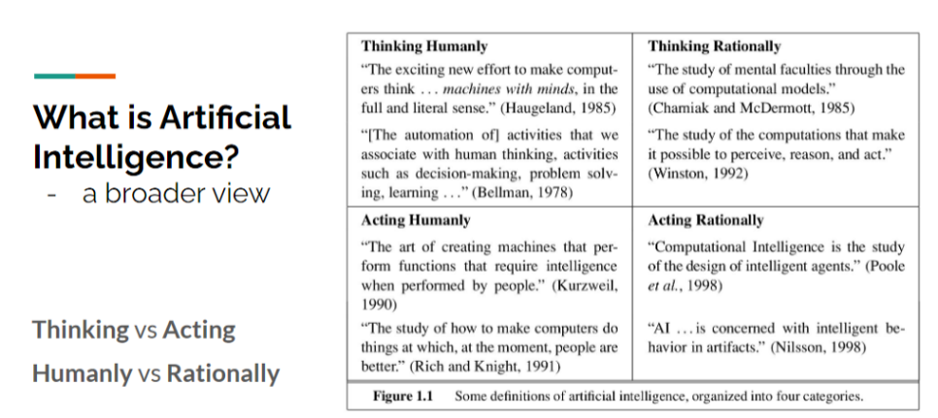
Building Artificial Intelligence – A broader view
Turing test
Source: Artificial Intelligence: A Modern Approach

Slide 15
Building Artificial Intelligence – challenges and opportunities
AI: The problem of building agents that are intelligent in the following way
AI agent: operate autonomously, perceive their environment, persist over a prolonged time, adapt to change, create and pursue goals
Intelligence is concerned with rational actions
An intelligent agent takes the best possible action
Approximately best possible action
Hard to know what is best in complex (many everyday) cases
Humans often do not do this (read e.g., “Thinking, Fast and Slow” by Kahneman)

Slide 16
Building Artificial Intelligence – challenges and opportunities
Solution focused (vs feature or process focused): When you buy a drilling machine, you are buying an ability to make holes, etc.
Goal of aeronautical engineering is not to make “machines that fly exactly like pigeons that they can fool even other pigeons.”
The Wright brothers stopped imitating birds and started using wind tunnels and learning aerodynamics
Find a valuable characteristic of flight/intelligence, a way to measure it (important for AI), and then recreate it artificially

Slide 17
Historical perspectives and evolution of AI

Slide 18
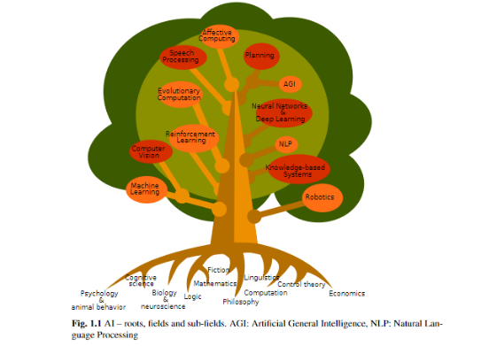
AI – Roots, fields, and subfields
AI is methods and ideas generating from fields of AI
Origin of AI
Super new field. Work began in earnest after World War II
Name was coined in 1956
However, AI has old roots

Slide 19
Prehistoric development
Formalizing thoughts and developing logic
Aristotle (384–322 B.C.): The first to formulate a set of laws governing the rational part of the mind, i.e., the “laws of thought”, e.g., “Socrates is a man; all men are mortal; therefore, Socrates is mortal.”
Charles Babbage and Ada Lovelace (~1800): Designs (CB) and programs (AL) two (uncompleted because funding ran out) mechanical computers
George Boole (1847): The Boolean logic (Boolean variable: True/False)

Slide 20
AI history begins in 1956
A 2-month workshop at Dartmouth (1956) organized by John McCarthy who also coined the term Artificial Intelligence
Automation theory, neural networks, and intelligence were discussed
All the big names, e.g., McCarthy, Minsky, Newell, Simon*, and Shannon
Newell, Simon, and Shaw brought the “Logic Theorist” – probably the first AI computer program
Why its own field? i.e., not under control theory, operations research, decision theory or math
The focus is on building machines that will function autonomously in complex, changing environments
Agency

Slide 21
Approaches to realizing AI - Knowledge Engineering (KE) Machine learning (ML)

Slide 22
Approaches to realizing AI
Two competing approaches to AI: Machine Learning (ML) vs Knowledge Engineering (KE)
KE: explicitly encode knowledge in machine language
GOFAI (Good Old-Fashioned AI) and Symbolic AI, Manipulate symbols according to rules, AI as “traditional computer programs”. E.g., knowledge-based systems and expert systems
Examples: Logical reasoning and proving theorems from “Principia Mathematica” (Newell and Simon, 1957), General Problem Solver (GPS): thinking humanly (Nevell and Simon, 1960s?)
The success of GPS led to the physical symbol system hypothesis: “a physical symbol system has the necessary and sufficient means for general intelligent action.” Newell and Simon (1976)
Tasks: proving theorems, micro-worlds and playing chess
ML: teach the machine to learn from data: AI as automatic programming, non-symbolic AI. E.g., random forests, neural nets, and deep learning

Slide 23
Knowledge Engineering (KE)
Knowledge Engineering
Dominant from mid 50s to the 80s, but still important
Based on high-level representations (i.e., human-readable)
Relies on search and logic
Originally focused on human-level intelligence
Although today the focus is on narrow AI
Often said to have failed (although this is not true)

Slide 24
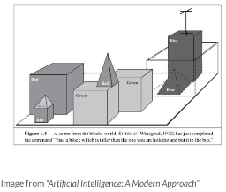
Knowledge Engineering (KE)
The Logic Theorist: early example of symbolic AI / KE; three rules of inference – substitution, replacement, detachment
Block world example: “Find a block which is taller than the one you are holding and put it in the box”
Commands in natural language but with a very restricted vocabulary
Kasparov vs Deep Blue (1996/97)
Watson to Jeopardy (Watson relies on ML too)

Slide 25
Challenges with Knowledge Engineering (KE) The combinatorial explosion
World cup for humans (bicycle kick): https://youtu.be/RM_5tJncHww
World cup for robots: https://en.wikipedia.org/wiki/RoboCup#2020
Simplified estimate of the number of possible states during Zlatan’s bicycle kick
640 skeletal muscles in the human body
Assume 100 of those need independent control
Assume that each muscle can be contracted to 10 different levels
Assume that the kick is made up of a sequence of 10 states
Any time point during the kick: 10 × 10 × 10 × ... × 10 = 10¹⁰⁰ possible states
The full kick (sequence): 10¹⁰⁰ × 10¹⁰⁰ × ... × 10¹⁰⁰ = (10¹⁰⁰)¹⁰ = 10¹⁰⁰⁰
The observable universe is estimated to hold < 10⁸² atoms

Slide 26
ML: teach the machine to learn from data (Neural Network)
AI as automatic programming, Non-symbolic AI, e.g., RF, NN, DL
Neural network: brain inspired computation; initial steps taken in 1940s/50s
Uses interconnected nodes or neurons in a layered structure that resembles the human brain
An adaptive system that learn from mistakes and improve continuously
Applications of neural network
Medical diagnosis by medical image classification
Targeted marketing by social network filtering and behavioral data analysis
Financial predictions by processing historical data of financial instruments
Electrical load and energy demand forecasting
Process and quality control
Chemical compound identification
Source: What Is A Neural Network? Retrieved from https://aws.amazon.com/what-is/neural-network/

Slide 27
Early applications and goals of AI

Slide 28
Early Applications of AI
AI in computing (50s)
Time-sharing
Sharing of a computing resource among multiple users
1st implementation of time-sharing user programs by John McCarthy* (1959)
Interpreters (like the Python interpreter)
The 1st high-level interpreted language – Lisp – was implemented by Steve Russell (inspired by McCarthy) and used for AI research
Linked list
Linear collection of data elements, whose order is not given by their physical placement in memory (i.e., different from an array)
1st implemented by Allen Newell**, Cliff Shaw and Herbert A. Simon** (1955-1956)
**Newell and Simon developed the GPS from the slide “In the early days: rigid rules in simple environments

Slide 29
Early Applications of AI
AI for fraud prevention (1987)
An Expert System for fraud-prevention knowledge-based systems
In 1987, Security Pacific National Bank, employed an Expert System to prevent debit card fraud at ATMs and sales counters
The application paid for itself in reduced losses in two months
AI in heavy industry – robots (1961 and onwards)
The 1st industrial robot – Unimate – worked the assembly line at GM in 1961
The MIT arm, later PUMA, developed by Victor Scheinman at MIT AI Lab during the 70s.
ABB Robotics developed – IRB 6 – the 1st commercially available microprocessor-controlled robot in 1974
In 2015 approx. 1,640,000 industrial robots were in use world-wide

Slide 30
Modern Applications of AI Capabilities and limitations

Slide 31
Applications of AI – speech recognition
AI for speech recognition and conversational interfaces
Mechanical Turks – Machines that pretend to be automatized but a human in the background is doing the work (e.g., chat bots, speech recognition from statistical learning approaches)
Deep Reinforcement Learning (DFL) – fed by human inputs
AI bots
Bots that look around for information
Bots that look around for information to complete a specific task
Bots with social abilities, i.e., social bots (difficult to define reward structure)
There will be transition from human-to-bot to bot-to-bot communication, where machines communicate among themselves and humans in the same way
Master bots – “universal bots” which everyone uses as gateways for their interfaces and applications
Follower bots – bots with dependence on master bots

Slide 32
Activity – AI in speech recognition
Transition from human-to-bot to bot-to-bot communication, where machines communicate among themselves and humans in the same way
Do you believe bots will communicate among themselves in programming languages or in simple easy to understand human languages (i.e., plain English)?
Does it solve “black box” issues in the machine learning environment?

Slide 33
Challenges – AI Applications in speech recognition
Progress in the last few years in deep learning models for speech recognition has been impressive
Deep-Q networks (DQNs), deep brief network (DBN), long short-term memory RNN, sequence-to-sequence learning, and tensor product representation
Challenges in building social AI bots
Machine translation still in early stage of the progress (Google’s Neural Machine translation, zero-short (learning in a language in which they were not trained for)
Speech recognition is still a supervised learning process
Human speech is complex, difficult to embed in machines
End-to-end trainable models – collaborations between different layers and a network which read through document having an internal representation of the document, base on the question it is trying to answer

Slide 34
Trends in AI Applications in speech recognition
Bot classification based on future trends and progress (native-enabler; generic-specific)
Employee bots: stand-alone, created for specific industry and applications
Examples: x.AI, MyAlly, Digit, Insurify, etc.
General user interfaces (GUI): general conversational interfaces
Examples: Siri, Cortana, Alexa, Sensay, Messenger, etc.
Bot contractors: hired to complete specific tasks, functional bots
Examples: MindMeld, Mezi, Msg.ai, Fuse Machines, Swelly, etc.
Bot factories: facilitates the creation of your own bots
Examples: Octane AI, Dexter, Motion.ai, Botsify, Pandorabots, etc.

Slide 35
Applications of AI – Insurance Industry
Insurance industry: One of the most old-fashioned and resistance-to-change (both risk and opportunity)
Traditional Business model
Identify customers for risk assessments
Targeting and selling differently priced products based on the risk profiles
Retaining for longer term by offering discounts, etc.
Products pushed by sales teams (sold, not bought)
Large volumes of data, across different parts of customers life
Most of the data is unstructured, semi-structured, and qualitative
Regulatory environment, complex operations, frauds, i.e., entry barriers for startups
Challenges – customer engagement, information sharing, incentive mechanism for information sharing

Slide 36
Applications of AI – Insurance Industry
AI applications in the insurance industry
Customer engagement
Personalized products, digitalizing records, robotic automation (e.g., policy renewals, modifications, etc.)
Higher awareness of risks, preventive measures, and benefits
AI will affect each stage of operational process related to identification of insurable risks
Identifying large number of similar exposure units
Estimating the accidental and unintentional loss (difficult to predict)
Determining risks factors and measurable loss
Estimating probability of measurable loss
Pricing feasible premiums

Slide 37
Applications of AI – Insurance Industry
AI will change each stage of operational process (e.g., identification of insurable risks, etc.)
With personalized products and detailed customer profiling: Identify large number of similar exposure units is not necessary
Changing customer behaviours (e.g., driving, health choices, etc.), estimating the accidental and unintentional loss is relatively easier
With better predictions and forecasts, the following tasks will be better managed
Determining risks factors and measurable loss
Estimating probability of measurable loss
Pricing feasible premiums

Slide 38
Applications of AI – Insurance Industry
Sector Innovators
Claim processing: Shift Technology, Tractable, ControlExpert, etc.
Virtual agents and chatbots: Spixii, Cognicor, Conversica, MD, MedWhat, etc.
Customer engagement: Oscar, Stride Health, Brolly, Captricity, etc.
Telematics: Greenroad, Vnomics, Telogis, etc.
Underwriting: Carpe Data, Atidot, Tyche, Cape Analytics, Dreamquark, SimpleInsurance, etc.
P2P Insurance: Lemonade, Friendsurance, Guevara
Smart Contracts: Elliptic, Everledger, Luther System, Dynamics, Saldo.mx, Teambrella, etc.
Insurance On-demand: Cuvva, Sure, Airsurety, Metromile, Digital Risks, Neosurance, etc.

Slide 39
Applications of AI – Financial Services
Financial services: data-rich but not data driven
Legacy systems, data silos, poor quality control, lack of vision and cultural mindset to adopt new technology
Innovation in financial services: imported innovation (vs internally generated), product focused (vs process focused)
AI is affecting the sector from all sides of the value chain and functional areas
Financial well-being: Kasisto, Trim, Acorns, Wealth-front, ZestFinance, etc.
Financial security: EyeVerify, Bionym, FaceFirst, Onfido, etc.
Payment processing and Money transfer: TrueAccord, LendUp, Kabbage, etc.
Capital and stock markets
Trading, DIY investing, market intelligence, alternative data, risk management
AI in financial service industry has lower barriers, plenty of data, and can provide higher ROI, compared to the other sectors

Slide 40
Activity – AI in Financial Services
Do you believe the future of banking includes the following?
No branches, no credit cards, no frauds, and no standard reporting
A platform with modular features with no physical products or space

Slide 41
Activity – Drivers of growth in AI
What are the key drivers of growth in AI in the last decade?
Technology
Economic and Development
Social and Cultural
Business environment

Slide 42
Key takeaways
AI will significantly change productivity, business environment, and economy in the coming years
Job reallocation, re-shifting, and job losses will characterize the global economy in the future
Identifying and exploiting the opportunities offered by AI will be the key challenges for the organizations and government in the future
Existing imbalance and inequalities can increase and decrease across sectors and need to be managed effectively

Slide 43
Recommended Readings
What is AI - The seven levels of AI. Warren Powell (2024) Retrieved from https://docs.google.com/document/d/1fPvKLARTLVe4OKNir6Ou-Dscyyn6UMyx/edit?pli=1
“Alan Turing – Celebrating the life of a genius” (8 min). Retrieved from https://www.youtube.com/watch?v=gtRLmL70TH0
Predicting AI: RIP Prof. Hubert Dreyfus (8 min). Retrieved from : https://youtu.be/B6Oigy1i3W4
A Timeline of the History of Artificial Intelligence. An interactive AI timeline. Retrieved from http://www.aaai.org/Timeline/timeline.php
Anyoha R. The History of Artificial Intelligence. Short history of AI with an emphasis on the importance computation played. Retrieved from http://sitn.hms.harvard.edu/flash/2017/history-artificial-intelligence/
An evolution of Models. Retrieved from https://www.stateoftheart.ai/models
Machines Who Think and the Early Days of AI. Podcast. Pamela McCorduck. Retrieved from https://lexfridman.com/pamela-mccorduck/
The book of Why. The new science of cause and effect. Judea Pearl and Dana Mackenzie. Retrieved from http://bayes.cs.ucla.edu/WHY/
What Is A Neural Network? Retrieved from https://aws.amazon.com/what-is/neural-network/

Slide 44
Appendix

Slide 45
Turing Machine
Objectives
Is there a general algorithmic procedure to resolve mathematical questions?*
Turing wanted to characterize which functions are computable by an “algorithmic procedure”
The Turing machine (1936) provides a mathematical model of “algorithmic procedure” (computation)
A Turing machine capable of simulating any computer algorithm can, in principle, be constructed
Universal Turing Machine: a Turing Machine that can simulate any other Turing Machine
*The question comes from the Entscheidungsproblem by David Hilbert (1928). Retrieved from https://en.wikipedia.org/wiki/Entscheidungsproblem

Slide 46
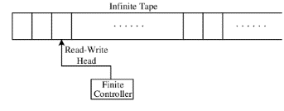
Turing Machine – Components
Infinite tape on which symbols can be read and written (memory)
A read-write head
A finite controller
A state register (stores the current state)
A finite table of instructions from where instructions are executed depending on the current state and the symbol read from the tape
Turing machine can compute anything that can be computed and needs arbitrary amount of memory and conditional branching (if-else).

Slide 47
Turing Completeness
Turing Completeness
A computer is Turing complete if it can solve any problem that a Turing machine can, given an appropriate algorithm, time, and memory
Turing complete computer → it can execute any algorithm
Turing complete programming language → it can execute any algorithm
Turing Prize: The highest distinction in computer science, ‘Nobel Prize’ of computing

Slide 48
The combinatorial explosion
A serious problem for search-based methods
Extremely rapid growth (≥ exponential) of the number of possible combinations in multi-dimensional environments
Many problems becomes intractable to solve by brute force search (and many types of heuristic search)
A simple world in which an agent tries to arrive to a goal state with different actions (i.e., a branching factor of 6)
Up to 3 steps to reach the goal: 6 + 6 × 6 + 6 × 6 × 6 = 258 possible sequences
Up to 6 steps: 6¹ + 6² + 6³ + 6⁴ + 6⁵ + 6⁶ = 55,986 sequences
Up to 24 steps: 5,686,057,605,985,940,274 (more than 5 quintillion) sequences

Slide 49
ML: Neural network – how does it work?
How do neural networks work?
Three interconnected layers – input, hidden, and output
Input: Get information from outside source, process and categorize it, and pass it on to the next layer
Hidden: Analyzes the output from the previous layer, processes it further, and passes it on to the next layer
Output: Gives the result of all the data processing by the artificial neural network.
It can have single or multiple nodes – with a binary (yes/no) classification problem, the output layer will have one output node, which will give the result as 1 or 0
With a multi-class classification problem, the output layer might consist of more than one output node
Source: What Is A Neural Network? Retrieved from https://aws.amazon.com/what-is/neural-network/

Slide 50
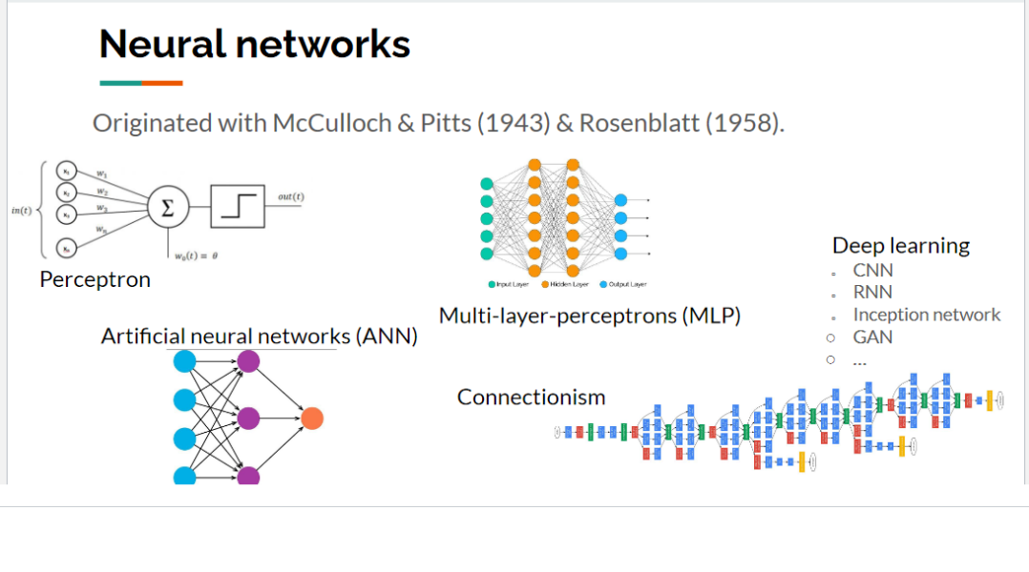
ML: Neural network – Types
Types of neural network – Feedforward neural networks, Backpropagation, Convolutional neural networks (CNNs)
Feedforward neural networks process data in one direction, from input to output
Backpropagation uses feedback loop to find correct path from input to output
Convolutional neural networks have hidden layers perform specific mathematical functions, like summarizing or filtering, called convolutions. The new form is easier to process without losing features that are critical for making a good prediction
Source: What Is A Neural Network? Retrieved from https://aws.amazon.com/what-is/neural-network/

